Slide 1

Statewide Transportation Strategy
2018 Monitoring Report
Tara Weidner, P.E., Oregon DOT
Transportation Planning Analysis Unit
TRB Planning Applications Conference , Portland, OR, June 3, 2109

Slide 2

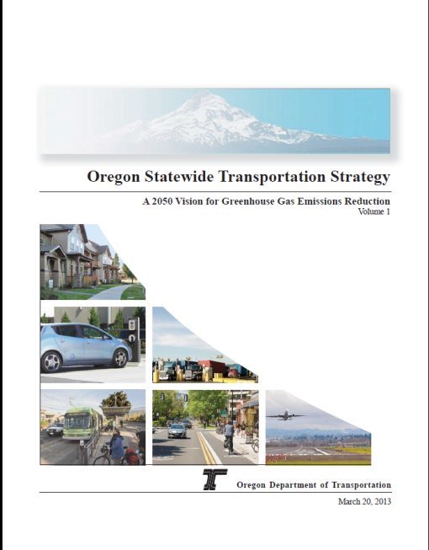
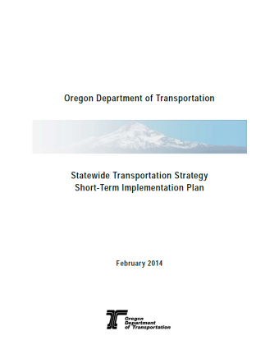
Statewide Transportation Strategy (STS)
Required by Legislature to Reduce Transportation GHG
What will it take by 2050? Ground, Freight, and Air
2018 Monitoring Report (5-yr updates)
2014 Implementation Plan
2013 Vision
(SB1059, HB2001)

Slide 3

Strategic Tool Developed
VisionEval Tools occupy a niche between…
Sketch model
quick, what-if, no network
micro-simulate
HHs/Vehicles
Activity
Based model
Integrated
model
economy, land use
& feedback
…balancing
rapid computation &
accurate representation
Exploratory tool for assessing risk/uncertainty in scenario planning visioning
Use more detailed traditional tools to implement vision
Pooled Fund
FHWA-Volpe
DOTs MPOs
▪ OR  Ohio  Las Vegas
▪ MD  NC  Atlanta
▪ WA  CA  Houston
  Visioneval.org

Slide 4
STS 2050 Visioning Process
-46%
Urban
UGB expansion
Transit service (4x pop. growth)
TDM (65% PDX hh & 40% of employers)
Parking pricing (+30% pay to park)
30% mode shift (for trips of <6 mi.)
Movement of People on the Ground
-74%
Enhanced Combo
➲ 40% mode shift
from SOV trips of
<6 mi (was 30%)
 More pay for
parking and at
higher cost
⇒ Ave. vehicle age
7.8 yrs (was 10
yrs)
 Increase in
PHEV and EV
(43%)
Increase in TDM
Commercial
services vehicles
are all electric or
natural gas
-69%
Enhanced + Price
 $0.15 per mile
VMT Tax in
addition to other
taxes (~$0.06 per
mile)
-45%
Tech
30% mode shift (for trips of <6 mi.)
PHEV & EV (+30%)
Renewable energy
Fuel carbon intensity (-20%)
Light truck ownership (-29%-36%)
-49%
-63%
System Optimization
Transit service (4x pop. growth)
Max System Ops & Mgmt.
Fuel efficiency priority (80% hh)
Carsharing rates up: high density
(1/2,500), medium density (1/5,000)
TDM
(65% PDX hh & 45% employers; more telecom.)
Speed smoothing
30% mode shift (for trips of <6 mi.)
Combo
Includes all assumptions
-75%
Enhanced + Tech
Cleaner power
generation
Increase PHEV &
EV (53%)
EVs have longer
range (cars = 300
mi)
-43%
Pricing
100% PAYD insurance
Parking pricing (+30% pay to park)
Pay for all external costs (+$0.06 per mi)
Congestion pricing ($.20/mi)

Slide 5
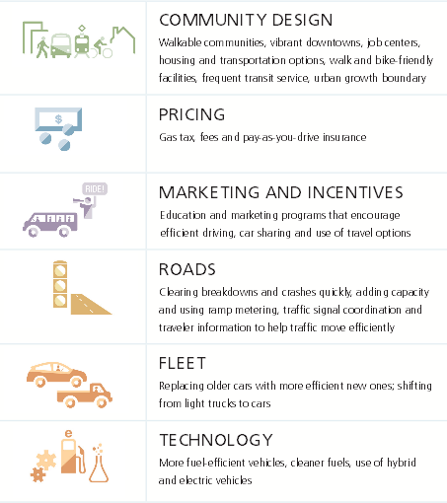


2013 STS Report
Transportation is 30% of GHG in Oregon
STS Vision achieves, 60% fewer GHG emissions than 1990 (~80% per capita)
Strategies
Vehicle and Fuels
Systems and Operations
Pricing
Transportation Options
Land Use
x

Slide 6
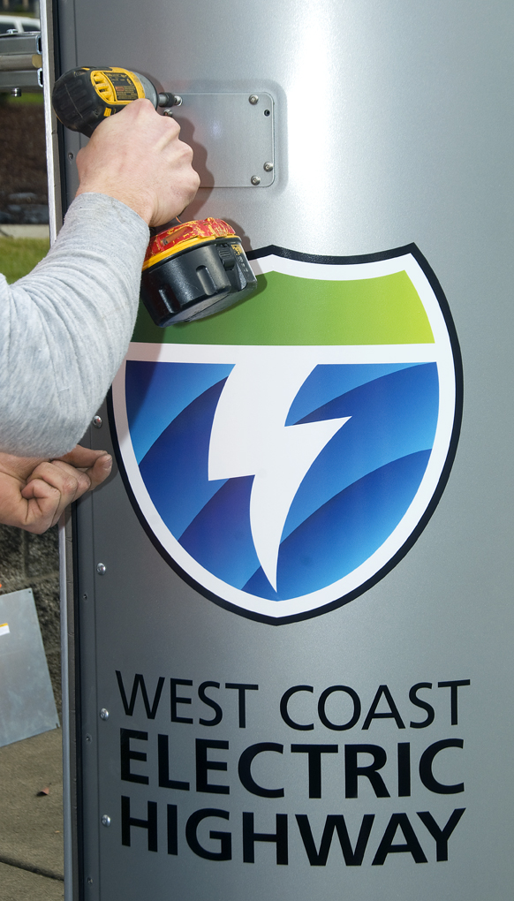


STS Implementation Progress
STS Short Term Implementation
Electric Vehicles & Low Emission Fuels
Eco-Driving Programs
Road User Charge Pilot
ITS deployment
Transportation Planning & Project Selection
Strategic Assessment & Scenario Planning
Stakeholder Coordination
ODOT Supporting Activities
Oregon Sustainable Transportation Initiative (OSTI)
State Mode and Topic Programs
HB2017 - Portland Value Pricing, Transit funding, etc.
  Oregon Planning efforts to date:
  Statewide: STS and modal plans
  Required: Metro, Central Lane
  Voluntary: CAMPO, RVMPO
  Climate Action Plans (Bend, others)
Stakeholder Coordination

Slide 7
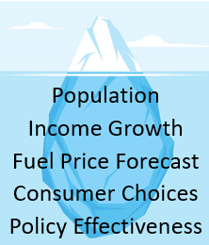
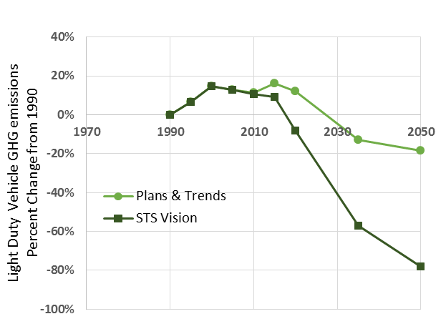
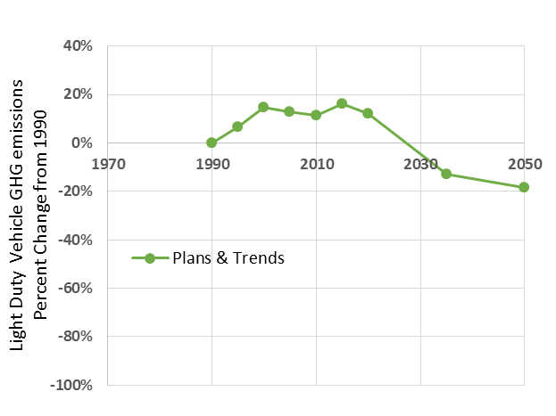
Percent Change in GHG Emissions from 1990
Good News
Federal CAFÉ standards
OR Clean Fuels Program
Electric Carbon Intensity
Car Manufacturer Actions
Most Local Plans on track through 2020
(road growth, parking)
Transit Funding (HB2017)
Tailwinds
Car share ➔ TNCs
Bike/Ped ➔ Electrics
Headwinds
Population
Economy/Income
Fuel Price & Pricing Policy
Consumer Choices
Potential range
Notes:
Very little of the vision is within ODOT authority, partners, synergies.

Slide 8
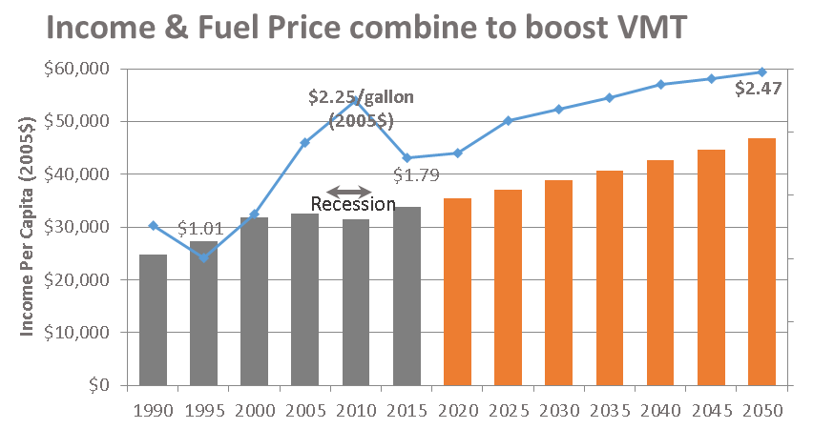
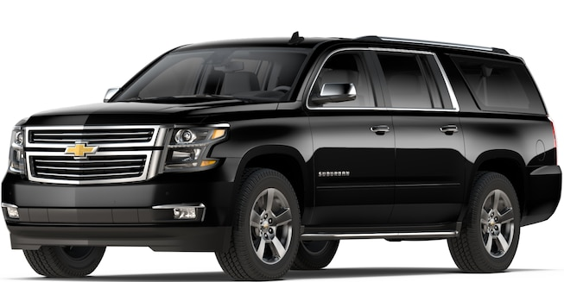
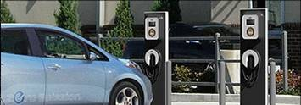
2015 Status: Restraining Forces
Plans & Trends vs. STS Vision
Near Term Restraining Forces
Headwinds
Lower gas prices
Higher Incomes
(2005$)
Consumer Choices
■ Older cars
More SUVs and trucks
■ Few no/low carbon vehicles yet

Slide 9


Synergistic effect on Vehicle Mix
Plans & Trends Scenario
Vehicle Sales Mix (Federal CAFÉ, ZEV/LEV)
STS Scenario
8-year Average Age
12 year Average Age
Powertrains
EV
Plug-in EV
Hybrid
Combustion
Auto
Light Truck/SUV
1975
2015
2050
ZEV
Program

Slide 10
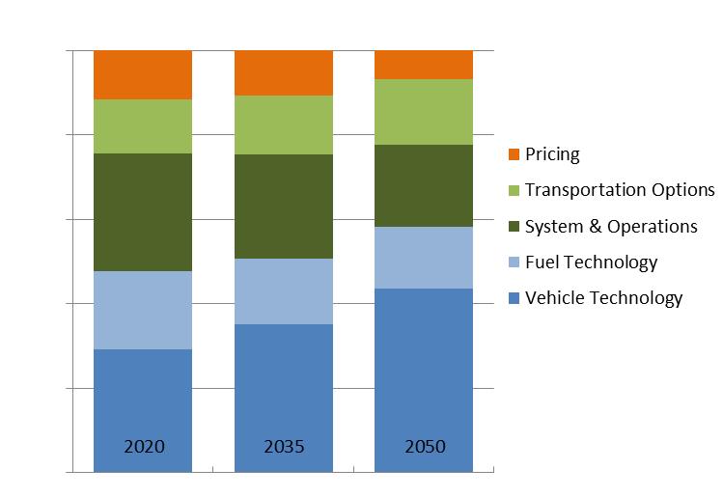

Gap to reach STS Vision
Relative Impact of remaining STS Strategies on Emissions (LDV) Reduction
Road Cost Recovery (Gas Taxes, VMT fee)
Social Cost Recovery (Carbon pricing)
Congestion Pricing
Pay-as-you-drive insurance
Transit service
Biking Walking, personal electrics
Car Sharing
Intelligent Transportation Systems
Demand Management programs
Driving Efficiency education
Parking coverage and fees
Road Growth
Fuels
Commercial Fleets
Vehicle Mix
Vehicle Fuel Economy (MPG)
UGB Growth
Population in Mixed Use areas
  Powerful
  Support other actions
  funding for quality options
Urban focus
impact less trips
often only enabling
Direct impact
impacts every mile of emissions
Pricing
Transportation
Options
System
Operations
Fuels
Vehicles
On
Track

Slide 11
Potential STS-Monitoring
Strategies
Potential Measure (data source) Grey= future source
Vehicle and Fuels
%Hybrids/EVs, MPG, %LtTrk, age (DMV, Motor Carrier-trucks)
Energy Carbon Intensity (Clean fuels program, Electric Utilities)
ITS deployment (MPO), EV charging -home, work, public
Road Lane Miles (HPMS)
Gas tax/registration, tolls, carbon fee
OreGo, PAYD participants (ODOT, state insurance agency)
Parking Fee areas, workers, rates (travel model), Cashout (MPO)
Transit Service (NTD), Transit Vehicle/Fuel Database
Bike facilities/connectivity (Level of Traffic Stress network)
Car Service availability (MPO)
TDM participation (funding levels, ride share app)
MPO %pop in Mixed Use Areas (travel model TAZ data)
UGB acre growth (DLCD)
Other: Pop growth (PRC), Income growth, Household size, (census) Fuel price (AEO)
Systems and Operations
Pricing
Transportation Options
Land Use

Slide 12
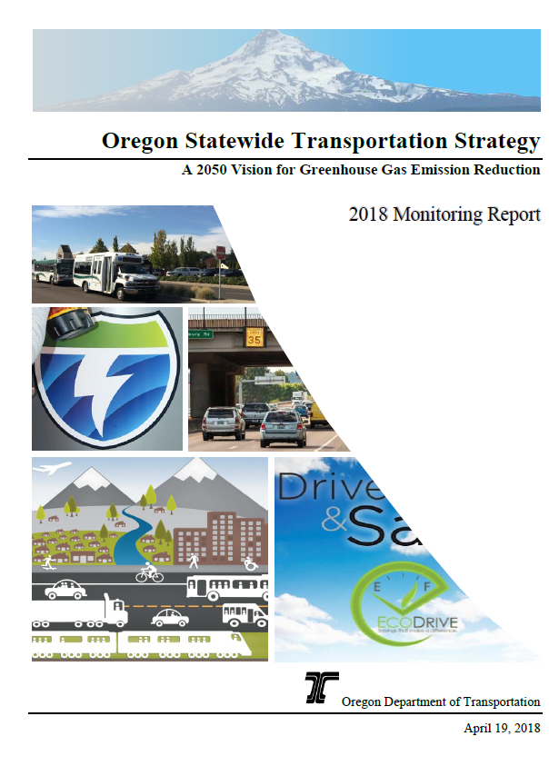
Questions?
Tara Weidner, Oregon DOT
Tara.j.weidner@odot.state.or.us
Pooled Fund
FHWA-Volpe
DOTs MPOs
▪ OR  Ohio  Las Vegas
▪ MD  NC  Atlanta
▪ WA  CA  Houston
  Visioneval.org
https://www.oregon.gov/ODOT/Planning/Documents/STS-2018-Monitoring-Report.pdf

